Slide 1
Arrays in Java
In Java, all arrays are dynamically allocated. (discussed below)
Arrays may be stored in contiguous memory [consecutive memory locations].
Since arrays are objects in Java, we can find their length using the object property length. This is different from C/C++, where we find length using sizeof.
A Java array variable can also be declared like other variables with [] after the data type.
The variables in the array are ordered, and each has an index beginning with 0.
Java array can also be used as a static field, a local variable, or a method parameter.

Slide 2
An array can contain primitives (int, char, etc.) and object (or non-primitive) references of a class depending on the definition of the array. In the case of primitive data types, the actual values might be stored in contiguous memory locations(JVM does not guarantee this behavior). In the case of class objects, the actual objects are stored in a heap segment.
One-Dimensional Arrays
The general form of a one-dimensional array declaration is
-- type var-name[]; -- type[] var-name;

Slide 3
An array declaration has two components: the type and the name. type declares the element type of the array. The element type determines the data type of each element that comprises the array. Like an array of integers, we can also create an array of other primitive data types like char, float, double, etc., or user-defined data types (objects of a class). Thus, the element type for the array determines what type of data the array will hold.

Slide 4
// both are valid declarations
int intArray[];
int[] intArray;
// similar to int we can declare
// byte , short, boolean, long, float
// double, char // an array of references to objects of
// the class MyClass (a class created by user)
MyClass myClassArray[];
// array of Object
Object[] ao,
// array of Collection
// of unknown type Collection[] ca;

Slide 5
Instantiating an Array in Java
When an array is declared, only a reference of an array is created. To create or give memory to the array, you create an array like this: The general form of new as it applies to one-dimensional arrays appears as follows:
var-name = new type [size];
Here, type specifies the type of data being allocated, size determines the number of elements in the array, and var-name is the name of the array variable that is linked to the array. To use new to allocate an array, you must specify the type and number of elements to allocate.

Slide 6
Example:
//declaring array int intArray[];
// allocating memory to array intArray = new int[20];
// combining both statements in one
int[] intArray = new int[20];
Note: The elements in the array allocated by new will automatically be initialized to zero (for numeric types), false (for boolean), or null (for reference types). Do refer to default array values in Java.
Obtaining an array is a two-step process. First, you must declare a variable of the desired array type. Second, you must allocate the memory to hold the array, using new, and assign it to the array variable. Thus, in Java, all arrays are dynamically allocated.

Slide 7
Array Literal in Java
In a situation where the size of the array and variables of the array are already known, array literals can be used.
// Declaring array literal int[] intArray = new int[]{ 1,2,3,4,5,6,7,8,9,10 };
The length of this array determines the length of the created array.
There is no need to write the new int[] part in the latest versions of Java.

Slide 8
Accessing Java Array Elements using for Loop
Each element in the array is accessed via its index. The index begins with 0 and ends at (total array size)-1.
All the elements of array can be accessed using Java for Loop.
// accessing the elements of the specified array
for (int i = 0; i < arr.length; i++)
System.out.println("Element at index " + i + " : "+ arr[i]);

Slide 9
// Java program to illustrate creating an array
// of integers, puts some values in the array,
// and prints each value to standard output.
class GFG
{
public static void main(String[] args)
{
// declares an Array of integers.
int[] arr;
// allocating memory for 5 integers.

Slide 10
arr = new int[5];
// initialize the first elements of the array
arr[0] = 10;
// initialize the second elements of the array
arr[1] = 20; // so on...
arr[2] = 30;
arr[3] = 40;
arr[4] = 50;
// accessing the elements of the specified array
for (int i = 0; i < arr.length; i++)
System.out.println("Element at index " + i + " : " + arr[i]); }
}

Slide 11
Exception Handling in Java
Exceptions in Java
Exception Handling in Java is one of the effective means to handle runtime errors so that the regular flow of the application can be preserved. Java Exception Handling is a mechanism to handle runtime errors such as ClassNotFoundException, IOException, SQLException, RemoteException, etc.
What are Java Exceptions?
In Java, Exception is an unwanted or unexpected event, which occurs during the execution of a program, i.e. at run time, that disrupts the normal flow of the program’s instructions. Exceptions can be caught and handled by the program. When an exception occurs within a method, it creates an object. This object is called the exception object. It contains information about the exception, such as the name and description of the exception and the state of the program when the exception occurred.

Slide 12
Major reasons why an exception Occurs
Invalid user input
Device failure
Loss of network connection
Physical limitations (out-of-disk memory)
Code errors
Opening an unavailable file
Errors represent irrecoverable conditions such as Java virtual machine (JVM) running out of memory, memory leaks, stack overflow errors, library incompatibility, infinite recursion, etc. Errors are usually beyond the control of the programmer, and we should not try to handle errors.

Slide 13
Difference between Error and Exception
Let us discuss the most important part which is the differences between Error and Exception that is as follows:
Error: An Error indicates a serious problem that a reasonable application should not try to catch.
Exception: Exception indicates conditions that a reasonable application might try to catch.
Exception Hierarchy
All exception and error types are subclasses of the class Throwable, which is the base class of the hierarchy. One branch is headed by Exception. This class is used for exceptional conditions that user programs should catch. NullPointerException is an example of such an exception. Another branch, Error is used by the Java run-time system(JVM) to indicate errors having to do with the run-time environment itself(JRE). StackOverflowError is an example of such an error.

Slide 14
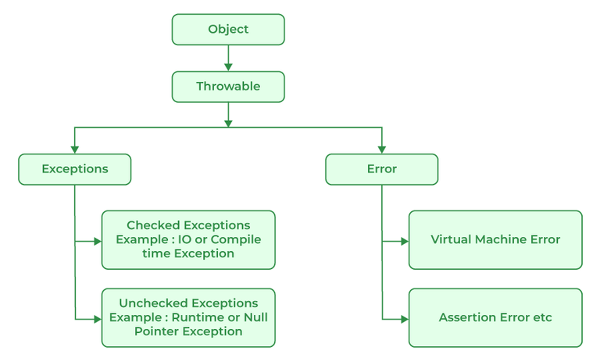

Slide 15
The Throwable class is the superclass of all errors and exceptions in the Java language. Only objects that are instances of this class (or one of its subclasses) are thrown by the Java Virtual Machine or can be thrown by the Java throw statement. Similarly, only this class or one of its subclasses can be the argument type in a catch clause. For the purposes of compile-time checking of exceptions, Throwable and any subclass of Throwable that is not also a subclass of either RuntimeException or Error are regarded as checked exceptions.
Instances of two subclasses, java.lang.Error and java.lang.Exception, are conventionally used to indicate that exceptional situations have occurred. Typically, these instances are freshly created in the context of the exceptional situation so as to include relevant information (such as stack trace data).
A throwable contains a snapshot of the execution stack of its thread at the time it was created. It can also contain a message string that gives more information about the error. Over time, a throwable can suppress other throwables from being propagated. Finally, the throwable can also contain a cause: another throwable that caused this throwable to be constructed. The recording of this causal information is referred to as the chained exception facility, as the cause can, itself, have a cause, and so on, leading to a "chain" of exceptions, each caused by another.

Slide 16
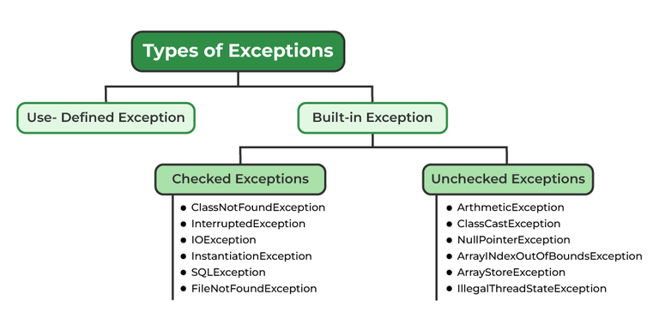
Types of Exceptions
Java defines several types of exceptions that relate to its various class libraries. Java also allows users to define their own exceptions.

Slide 17
Exceptions can be categorized in two ways:
Built-in Exceptions
Checked Exception
Unchecked Exception
User-Defined Exceptions
Let us discuss the above-defined listed exception that is as follows:
1. Built-in Exceptions
Built-in exceptions are the exceptions that are available in Java libraries. These exceptions are suitable to explain certain error situations.
Checked Exceptions: Checked exceptions are called compile-time exceptions because these exceptions are checked at compile-time by the compiler.
Unchecked Exceptions: The unchecked exceptions are just opposite to the checked exceptions. The compiler will not check these exceptions at compile time. In simple words, if a program throws an unchecked exception, and even if we didn’t handle or declare it, the program would not give a compilation error.

Slide 18
2. User-Defined Exceptions:
Sometimes, the built-in exceptions in Java are not able to describe a certain situation. In such cases, users can also create exceptions, which are called ‘user-defined Exceptions’.
The advantages of Exception Handling in Java are as follows:
Provision to Complete Program Execution
Easy Identification of Program Code and Error-Handling Code
Propagation of Errors
Meaningful Error Reporting
Identifying Error Types
Methods to print the Exception information:
1. printStackTrace()
This method prints exception information in the format of the Name of the exception: description of the exception, stack trace.

Slide 19
//program to print the exception information using printStackTrace() method
import java.io.*;
class GFG
{
public static void main (String[] args)
{
int a=5; int b=0;
Try
{
System.out.println(a/b); }
catch(ArithmeticException e)
{
e.printStackTrace(); }
}
}

Slide 20
Output
java.lang.ArithmeticException: / by zero at GFG.main(File.java:10)
2. toString()
The toString() method prints exception information in the format of the Name of the exception: description of the exception.

Slide 21
//program to print the exception information using toString() method import java.io.*;
class GFG1
{
public static void main (String[] args)
{
int a=5; int b=0;
try{
System.out.println(a/b);
}
catch(ArithmeticException e)
{
System.out.println(e.toString());
}
}
}

Slide 22
2. toString()
The toString() method prints exception information in the format of the Name of the exception: description of the exception.
//program to print the exception information using toString() method
import java.io.*;
class GFG1 {
public static void main (String[] args) {
int a=5;
int b=0;
try{
System.out.println(a/b);
}
catch(ArithmeticException e){
System.out.println(e.toString());
}
}
}

Slide 23
Output
java.lang.ArithmeticException: / by zero3.
getMessage()
The getMessage() method prints only the description of the exception.

Slide 24
import java.io.*;
class GFG1 {
public static void main (String[] args) {
int a=5;
int b=0;
try{
System.out.println(a/b);
}
catch(ArithmeticException e){
System.out.println(e.getMessage());
}
}
}
Output
/ by zero

Slide 25
How Does JVM Handle an Exception?
Default Exception Handling: Whenever inside a method, if an exception has occurred, the method creates an Object known as an Exception Object and hands it off to the run-time system(JVM). The exception object contains the name and description of the exception and the current state of the program where the exception has occurred. Creating the Exception Object and handling it in the run-time system is called throwing an Exception. There might be a list of the methods that had been called to get to the method where an exception occurred. This ordered list of methods is called Call Stack. Now the following procedure will happen.

Slide 26
The run-time system searches the call stack to find the method that contains a block of code that can handle the occurred exception. The block of the code is called an Exception handler.
The run-time system starts searching from the method in which the exception occurred and proceeds through the call stack in the reverse order in which methods were called.
If it finds an appropriate handler, then it passes the occurred exception to it. An appropriate handler means the type of exception object thrown matches the type of exception object it can handle.
If the run-time system searches all the methods on the call stack and couldn’t have found the appropriate handler, then the run-time system handover the Exception Object to the default exception handler, which is part of the run-time system. This handler prints the exception information in the following format and terminates the program abnormally.

Slide 27
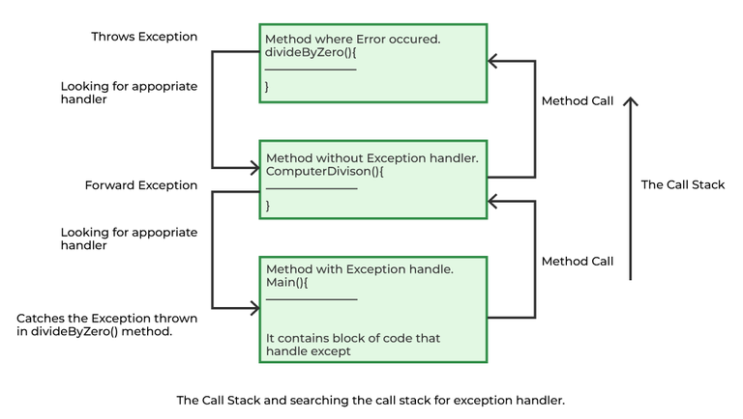
Exception in thread "xxx" Name of Exception : Description ... ...... .. // Call Stack

Slide 28
// Java Program to Demonstrate How Exception Is Thrown
// Class
// ThrowsExecp
class GFG
{
// Main driver method
public static void main(String args[])
{
// Taking an empty string
String str = null;
// Getting length of a string
System.out.println(str.length()); } }

Slide 29
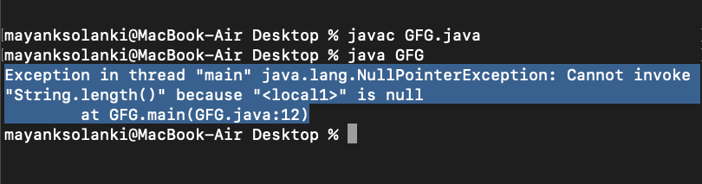

Slide 30
Let us see an example that illustrates how a run-time system searches for appropriate exception handling code on the call stack.
// Java Program to Demonstrate Exception is Thrown
// How the runTime System Searches Call-Stack
// to Find Appropriate Exception Handler
// Class
// ExceptionThrown
class GFG {
// Method 1
// It throws the Exception(ArithmeticException).
// Appropriate Exception handler is not found
// within this method.

Slide 31
static int divideByZero(int a, int b)
{
// this statement will cause ArithmeticException
// (/by zero)
int i = a / b;
return i;
}
// The runTime System searches the appropriate
// Exception handler in method also but couldn't have
// found. So looking forward on the call stack
static int computeDivision(int a, int b)
{ int res = 0;
// Try block to check for exceptions
try {
res = divideByZero(a, b); }

Slide 32
// Catch block to handle NumberFormatException
// exception Doesn't matches with
// ArithmeticException
catch (NumberFormatException ex) {
// Display message when exception occurs
System.out.println(
"NumberFormatException is occurred");
}
return res;
}
// Method 2
// Found appropriate Exception handler.
// i.e. matching catch block.
public static void main(String args[])
{

Slide 33
int a = 1;
int b = 0;
// Try block to check for exceptions
try {
int i = computeDivision(a, b);
}
// Catch block to handle ArithmeticException
// exceptions
catch (ArithmeticException ex) {
// getMessage() will print description
// of exception(here / by zero)
System.out.println(ex.getMessage());
}
}
}

Slide 34
Output
/ by zero

Slide 35
Checked vs Unchecked Exceptions in Java
In Java, Exception is an unwanted or unexpected event, which occurs during the execution of a program, i.e. at run time, that disrupts the normal flow of the program’s instructions.
In Java, there are two types of exceptions:
Checked exceptions
Unchecked exceptions

Slide 36
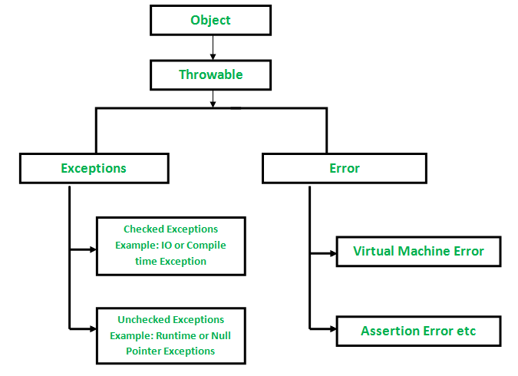

Slide 37
Checked Exceptions in Java
These are the exceptions that are checked at compile time. If some code within a method throws a checked exception, then the method must either handle the exception or it must specify the exception using the throws keyword. In checked exceptions, there are two types: fully checked and partially checked exceptions. A fully checked exception is a checked exception where all its child classes are also checked, like IOException, and InterruptedException. A partially checked exception is a checked exception where some of its child classes are unchecked, like an Exception.
For example, consider the following Java program that opens the file at location “C:\test\a.txt” and prints the first three lines of it. The program doesn’t compile, because the function main() uses FileReader(), and FileReader() throws a checked exception FileNotFoundException. It also uses readLine() and close() methods, and these methods also throw checked exception IOException
Example:

Slide 38
// Java Program to Illustrate Checked Exceptions
// Where FileNotFoundException occurred
// Importing I/O classes
import java.io.*;
// Main class
class GFG
{
// Main driver method
public static void main(String[] args)
{
// Reading file from path in local directory
FileReader file = new FileReader("C:\\test\\a.txt");
// Creating object as one of ways of taking input BufferedReader fileInput = new BufferedReader(file);
// Printing first 3 lines of file "C:\test\a.txt"

Slide 39
for (int counter = 0; counter < 3; counter++)
System.out.println(fileInput.readLine());
// Closing file connections
// using close() method
fileInput.close();
}
}

Slide 40
Blocks and Keywords Used For Exception Handling
1. try in Java
The try block contains a set of statements where an exception can occur.
try { // statement(s) that might cause exception }
2. catch in Java
The catch block is used to handle the uncertain condition of a try block. A try block is always followed by a catch block, which handles the exception that occurs in the associated try block.
catch { // statement(s) that handle an exception // examples, closing a connection, closing // file, exiting the process after writing // details to a log file. }

Slide 41
3. throw in Java
The throw keyword is used to transfer control from the try block to the catch block.
// Java program that demonstrates the use of throw
class ThrowExcep {
static void help()
{
try {
throw new NullPointerException("error_unknown");
}
catch (NullPointerException e) {
System.out.println("Caught inside help().");
// rethrowing the exception
throw e;
}
}

Slide 42
public static void main(String args[])
{
try {
help();
}
catch (NullPointerException e) {
System.out.println(
"Caught in main error name given below:");
System.out.println(e);
}
}
}
Output
Caught inside help(). Caught in main error name given below: java.lang.NullPointerException: error_unknown

Slide 43
4. throws in Java
The throws keyword is used for exception handling without try & catch block. It specifies the exceptions that a method can throw to the caller and does not handle itself.
// Java program to demonstrate working of throws
class ThrowsExecp {
// This method throws an exception
// to be handled
// by caller or caller
// of caller and so on.
static void fun() throws IllegalAccessException
{
System.out.println("Inside fun(). ");
throw new IllegalAccessException("demo");
}

Slide 44
// This is a caller function
public static void main(String args[])
{
try {
fun();
}
catch (IllegalAccessException e) {
System.out.println("caught in main.");
}
}
}
Output
Inside fun(). caught in main.

Slide 45
5. finally in Java
It is executed after the catch block. We use it to put some common code (to be executed irrespective of whether an exception has occurred or not ) when there are multiple catch blocks.
An example of an exception generated by the system is given below:
Exception in thread "main" java.lang.ArithmeticException: divide by zero at ExceptionDemo.main(ExceptionDemo.java:5) ExceptionDemo: The class name main:The method name ExceptionDemo.java:The file name java:5:line number

Slide 46
// Java program to demonstrate working of try,
// catch and finally
class Division {
public static void main(String[] args)
{
int a = 10, b = 5, c = 5, result;
try {
result = a / (b - c);
System.out.println("result" + result);
}
catch (ArithmeticException e) {
System.out.println("Exception caught:Division by zero");
}
finally {
System.out.println("I am in final block");
}
}
}

Slide 47
Exception caught:Division by zero I am in final block

Slide 48
1. When should you use try catch blocks?
Try catch blocks are used to avoid exceptions so that code doesn’t break before the full execution.
2. What is throw and throws in Java?
The throw is used for transferring control from the try block to the catch block. Whereas throws is used for exception handling without try & catch block. Throws specify the exceptions that a method can throw to the caller and does not handle itself.
3. Can we have two catch blocks?
Yes, we can have multiple catch blocks with try statements.

